Slide 1




INTELLIGENT PLANT MONITORING SYSTEM
Here is where your presentation begins -
Submitted by :-
SATYAM KUMAR MISHRA (21BEIG85)
ANUSHA MOHANTY (21BEIF06)
BIBHU PRASAD SAHU(21BEIG61)
MANAS KUMAR SAHU(21BEIG49)
SATYA SARATHI (21BEIG63)

Slide 2
PRESENTATION FLOW
Introduction
Problem Statement
Objectives
Block Diagram
Technology Used
Components Required
Result
Applications
Future Scope
References

Slide 3
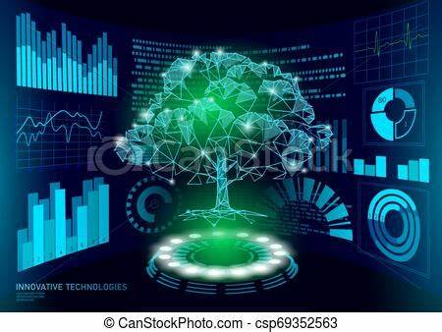
INTRODUCTION
Technology-driven system that provides automated watering and irrigation to plants
Our system monitors soil moisture, temperature, and humidity levels and provides the right amount of water needed by the plants
With the help of this system, plants can receive a consistent supply of water, even in the absence of their caretaker

Slide 4
PROBLEM STATEMENT
The problem that a smart plant watering system aims to solve is the challenge of providing the right amount of water to plants consistently
Many plant owners struggle with maintaining the correct soil moisture levels, which can result in underwatering or overwatering, both of which can be detrimental to plant health
Underwatering can lead to wilting, stunted growth, and even death, while overwatering can cause root rot, nutrient depletion, and other issues
Additionally, traditional watering methods can be time-consuming and wasteful, and not everyone has the knowledge or expertise to identify the exact needs of each plant they own

Slide 5
OBJECTIVES
Automate the watering process
Improve the plant health
Save water
Save time and effort
Monitor plant conditions
Provide remote control and monitoring

Slide 6
BLOCK DIAGRAM
ESP 8266
Sensor Module
Relay
Water pump
PC/ Laptop
Power Supply

Slide 7
TECHNOLOGY USED
APPLICATIONS
SERVICES
SENSORS
WATER MONITORING
MOISTURE SENSOR
TEMPERATURE SENSOR
SOIL MONITORING
Plant
Watering
HUMIDITY
SENSOR
ENVIRONMENTALMONITORING
MOISTURE
HUMIDITY
CLOUD
ESP 32

Slide 8

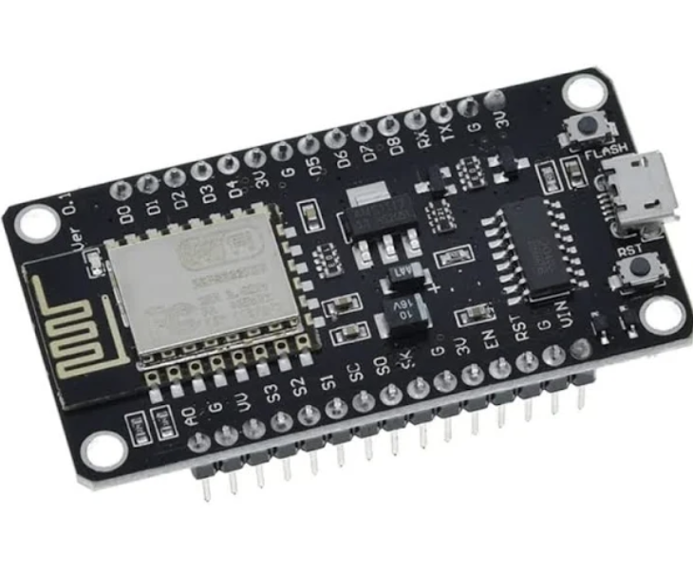

COMPONENTS REQUIRED
ESP 8266
The ESP8266 is a low-cost Wi-Fi microchip, with built-in TCP/IP networking software
Integrated Wi-Fi (802.11 b/g/n) and Bluetooth 4.2-
Flash memory of up to 16 MB
RAM of up to 520 KB
34 GPIO pins (general-purpose input/output)
Support for interfaces such as SPI, I2C, UART, ADC, DAC, PWM, and more
Low power consumption (deep sleep mode with less than 5 μA)

Slide 9
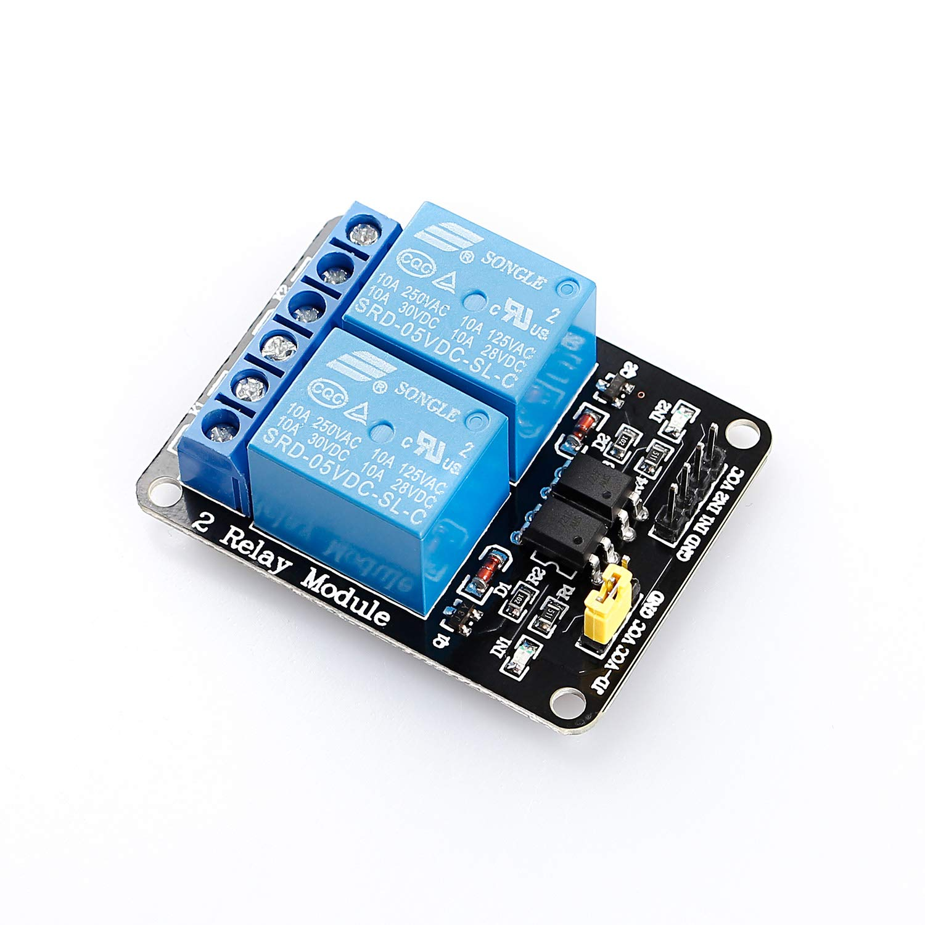
RELAY
A relay is an electronic switch that can be used to control the flow of current in an electrical circuit
Common specifications are –
Contact configuration: This specifies the type and number of contacts in the relay, such as normally open (NO), normally closed (NC), or changeover (CO).
Relays are an important component in many electronic systems and are widely used in industrial control, automation, and other applications where precise control of electrical power is required.

Slide 10
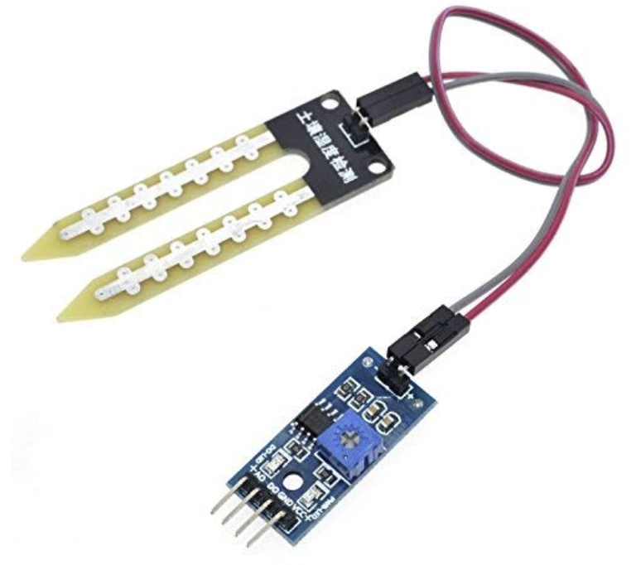
CAPACITIVE SOIL MOISTURE SENSOR
A capacitive soil moisture sensor is an electronic device that measures the moisture content of soil by detecting changes in the capacitance of a capacitor embedded in the sensor.
They can be connected to microcontrollers or other devices that can read the output signal and trigger actions based on the soil moisture levels.
Operating voltage: 3.3V - 5V DC
Output voltage range: 0 - 3V DC
Measurement range: 0 - 100% soil moisture
Accuracy: ±5%

Slide 11
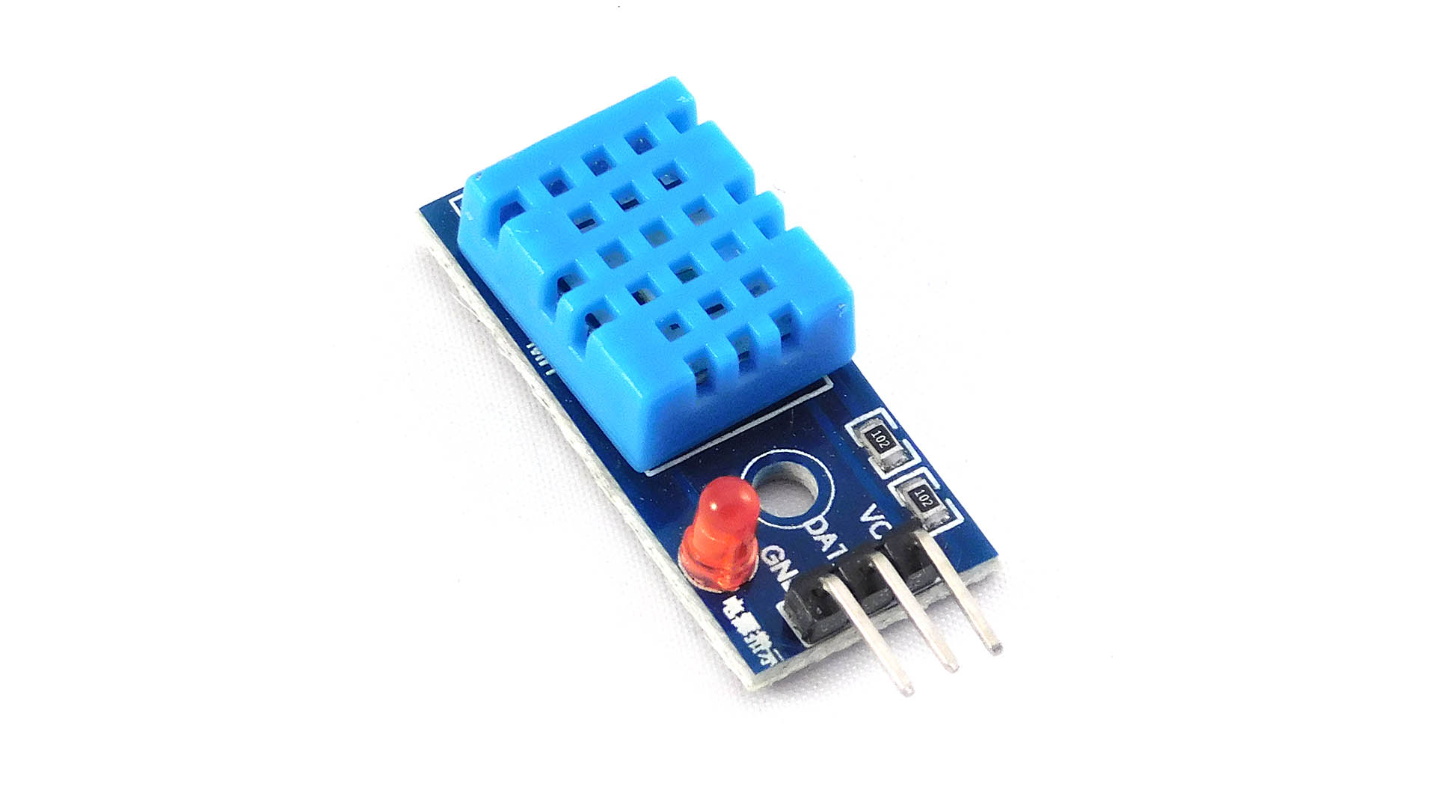
DHT11
The DHT11 sensor is a low-cost digital temperature and humidity sensor that is commonly used in electronic projects and IoT applications.
It can be integrated with microcontrollers, such as Arduino, Raspberry Pi, or ESP32, to build custom projects and systems that require temperature and humidity sensing.
Operating voltage: 3.3V - 5.5V DC
Temperature measurement range: -40°C to +80°C
Humidity measurement range: 20% to 90% RH
Accuracy: ±2°C for temperature, ±5% for humidity

Slide 12
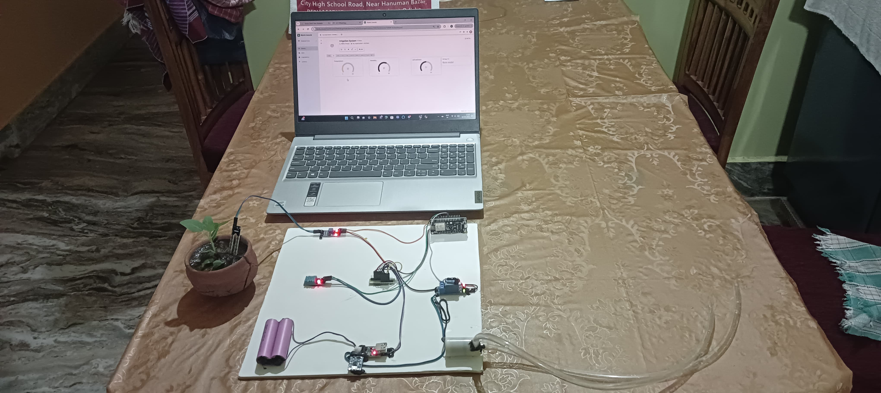

RESULT

Slide 13
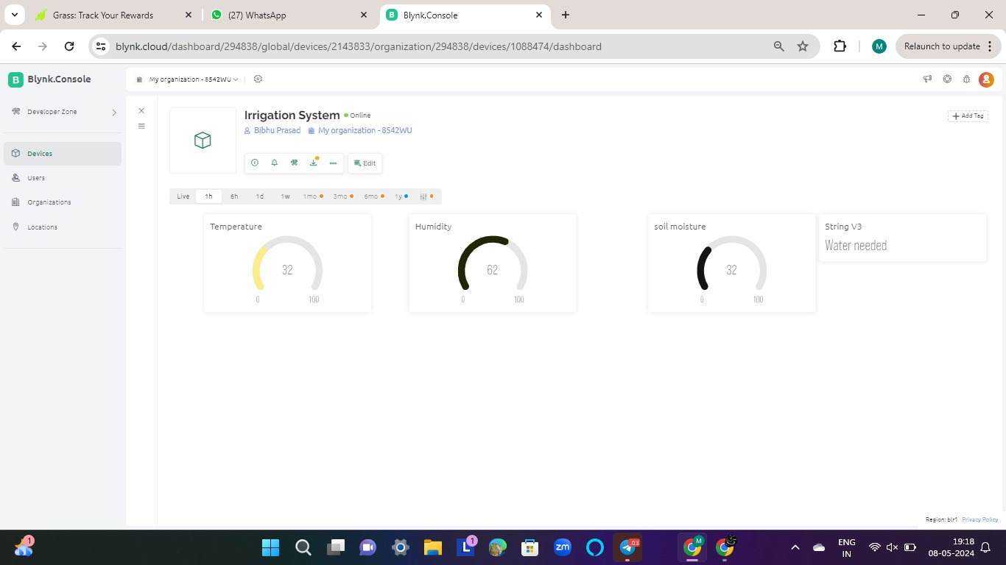

Slide 14
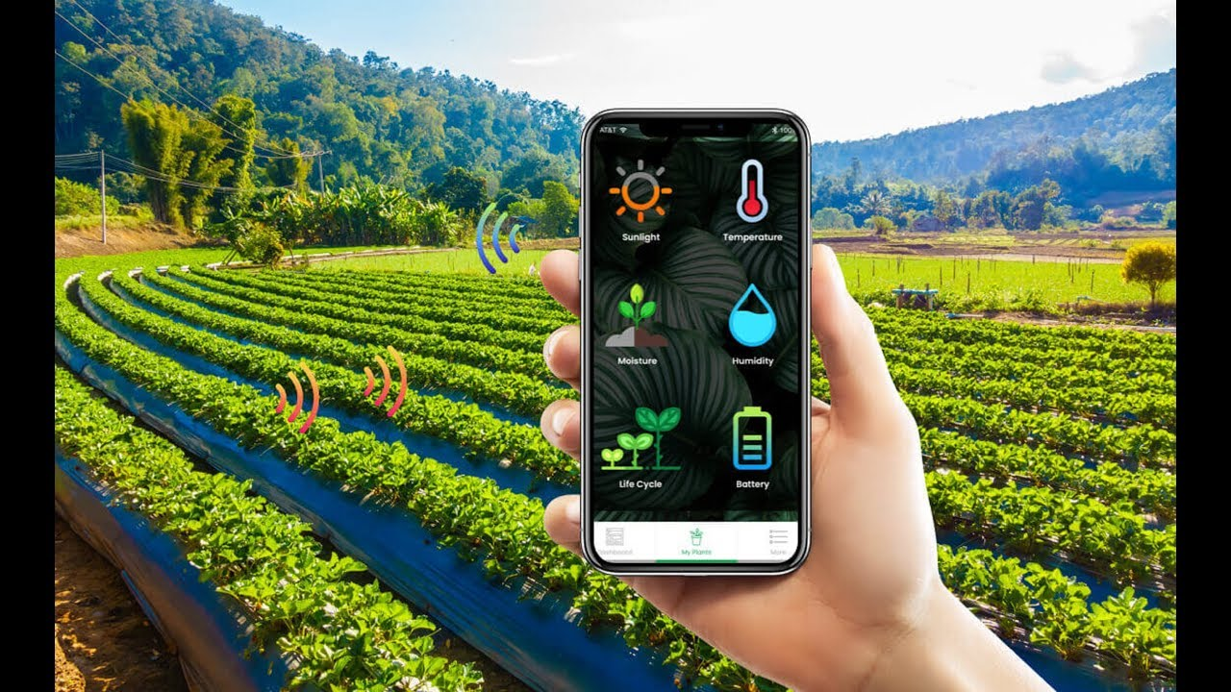
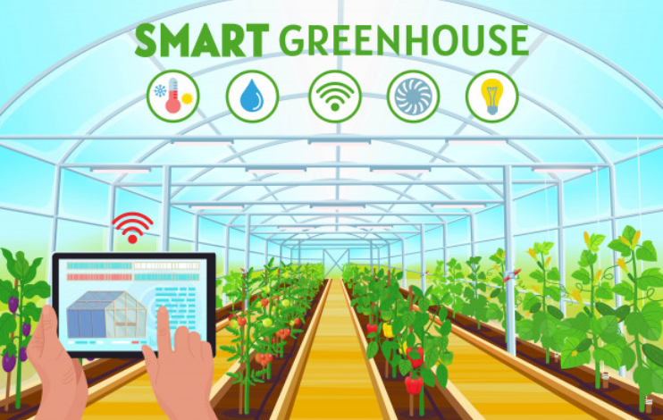
APPLICATIONS
Agriculture: Smart watering systems can be used in agriculture to optimize irrigation schedules, reduce water usage, and increase crop yields
Landscaping: Smart watering systems can be used to maintain public parks and other landscaped areas, reducing maintenance costs and ensuring that the vegetation remains healthy and attractive
Greenhouses: Smart watering systems can be used in greenhouses to provide precise control over watering schedules and nutrient delivery, which can improve crop yields and quality

Slide 15
FUTURE SCOPE
Now, we can monitor and control our plant health from anywhere in the world
Our future work will address further improvements of the smart pot by attaching further sensors, and we also plan to extend the IoT-Cloud gateway with additional services for postprocessing the monitored environmental data
Use Artificial Intelligence
Integration with other smart devices
Improved Sensors

Slide 16
REFERENCES
https://iotcircuithub.com/indoor-plant-watering-system-esp32/
SMART IRRIGATION SYSTEM | IEEE Conference Publication | IEEE Xplore
Search · smart irrigation with esp32 · GitHub
ESP32 - Soil Moisture Sensor | ESP32 Tutorial (esp32io.com)
How to make Automatic Plant Watering System using Arduino UNO and Soil Sensor || Techie Lagan – YouTube

Slide 17

Thanks!

